Slide 1
Automation Testing OF ANDROID Application
Date : 2 January 2020

Slide 2
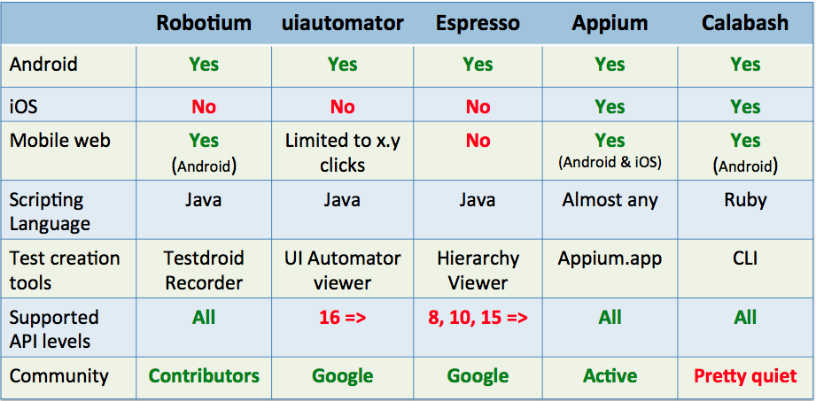
WHY APPIUM?

Slide 3
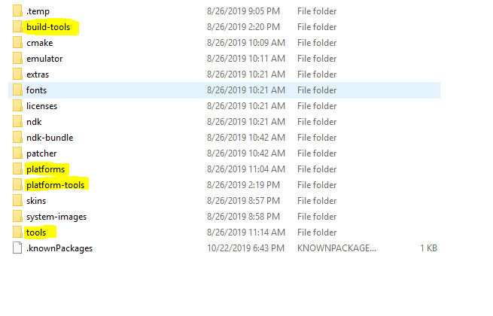
SDK Build tool
SDK BUILD TOOL is mandatory for Android application development.
Below are the folder structure of android sdk-

Slide 4
Environment Variables
In System Variable, add new variable and it’s values as shown below-
ANDROID_HOME = E:\Android_SDK
and also add PATH variable as shown below-
%ANDROID_HOME%\platform-tools
%ANDROID_HOME%\tools
%ANDROID_HOME%\platforms

Slide 5
ANDROID DEBUG bridge
ADB, It’s a part of Android SDK and it is made up of three components- a client, a server and a daemon.
ADB is located in below path-
%ANDROID_HOME%\platform-tools\
It is used to manage either an emulator instance and/or actual android device.
By Using ADB, developer can debug an complete android application(90% of developer are not using this way of debugging)
If your Android App is dealing with the Android OS in such scenarios ADB is comes in the picture for debug.

Slide 6
Demo
Let’s Start Demo..

Slide 7
Demo
Required software
1. Android Studio
2. Pycharm
3. Python
4. Nodejs
5. Appium packages
6.Java

Slide 8
Demo
Android Studio
Android Studio is the integrated development environment(IDE) for Google's Android operating system
It is built on JetBrains IntelliJ IDEA software and designed specifically for Android development
It is available for download on Windows, macOS and Linux based operating system.

Slide 9
Introduction to Appium
Appium
Appium is an open-source tool for automating native, mobile web, and hybrid applications on iOS mobile, Android mobile, and Windows desktop platforms
Appium Server
Server written in Node.js
Appium Clients
Client libraries
Java, Ruby ,Python

Slide 10
APP AUTOMATION DEMO
Node.js
Node.js is an open source server environment
Node.js runs on various platforms (Windows, Linux, Unix, Mac OS X, etc.
Node.js uses JavaScript on the server

Slide 11
APP AUTOMATION DEMO
Appium Packages
appium-android-driver
takes care of installing android packages to the device
runs chrome driver sessions if desired
uses appium-adb to talk to the emulator/ simulator/ real device
appium-adb
wrapper around the Android Debug Bridge (adb)
allows special (mobile specific) emulator commands that are not related to the web driver protocol like
locking the screen
press back button
press home button

Slide 12
APP AUTOMATION DEMO
UI Automator
UI Automator is a UI testing framework suitable for cross-app functional UI testing across system and installed apps.
UI Automator viewer
The uiautomator viewer tool provides a convenient GUI to scan and analyze the UI components currently displayed on an Android device

Slide 13
APP AUTOMATION DEMO
UNIT TEST
It supports test automation, sharing of setup and shutdown code for tests, aggregation of tests into collections, and independence of the tests from the reporting framework.

Slide 14
APP AUTOMATION DEMO
WebDriver
It is a tool for testing web applications across different browsers using different programming languages.
WebDriver allows you to use a programming language of your choice in designing your tests.
WebDriver is simpler architecture.
The only drawback of WebDriver is:
It does not have a built-in command for automatic generation of test results.

Slide 15
APP AUTOMATION DEMO
There are multiple ways to identify a specific element. With the uiautomatorviewer and the Appium Desktop it’s fairly easy to figure out what those identifiers are and what of those you can use to find elements.
1. Accessibility ID
2. Class name
3. ID (resource-id)
4. Xpath
5. Name
6. Index Value

Slide 16
APP AUTOMATION DEMO
Android Key Codes List
The following is a partial list of some commonly used Key Codes:
'a' - 'z' --- 29 - 54
'0' - '9‘ --- 7 - 16
SPACE --- 62
ENTER --- 66
BACKSPACE --- 67
BACK --- 4
Driver.presskeycode()
Send_keys.()

Slide 17
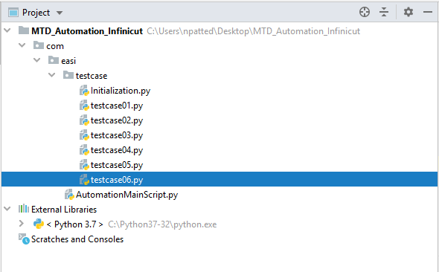
APP AUTOMATION DEMO
Project Architecture

Slide 18
Thank you

